Slide 1
Object Recognition Using Neural Networks
Presenter: Edward Preble
Co-Investigators: Ian Thomas, Kasey Jones, Rob Chew
DOG
CAT

Slide 2
Sooooo complicated…. do I REALLY need to care???
YES

Slide 3
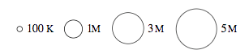
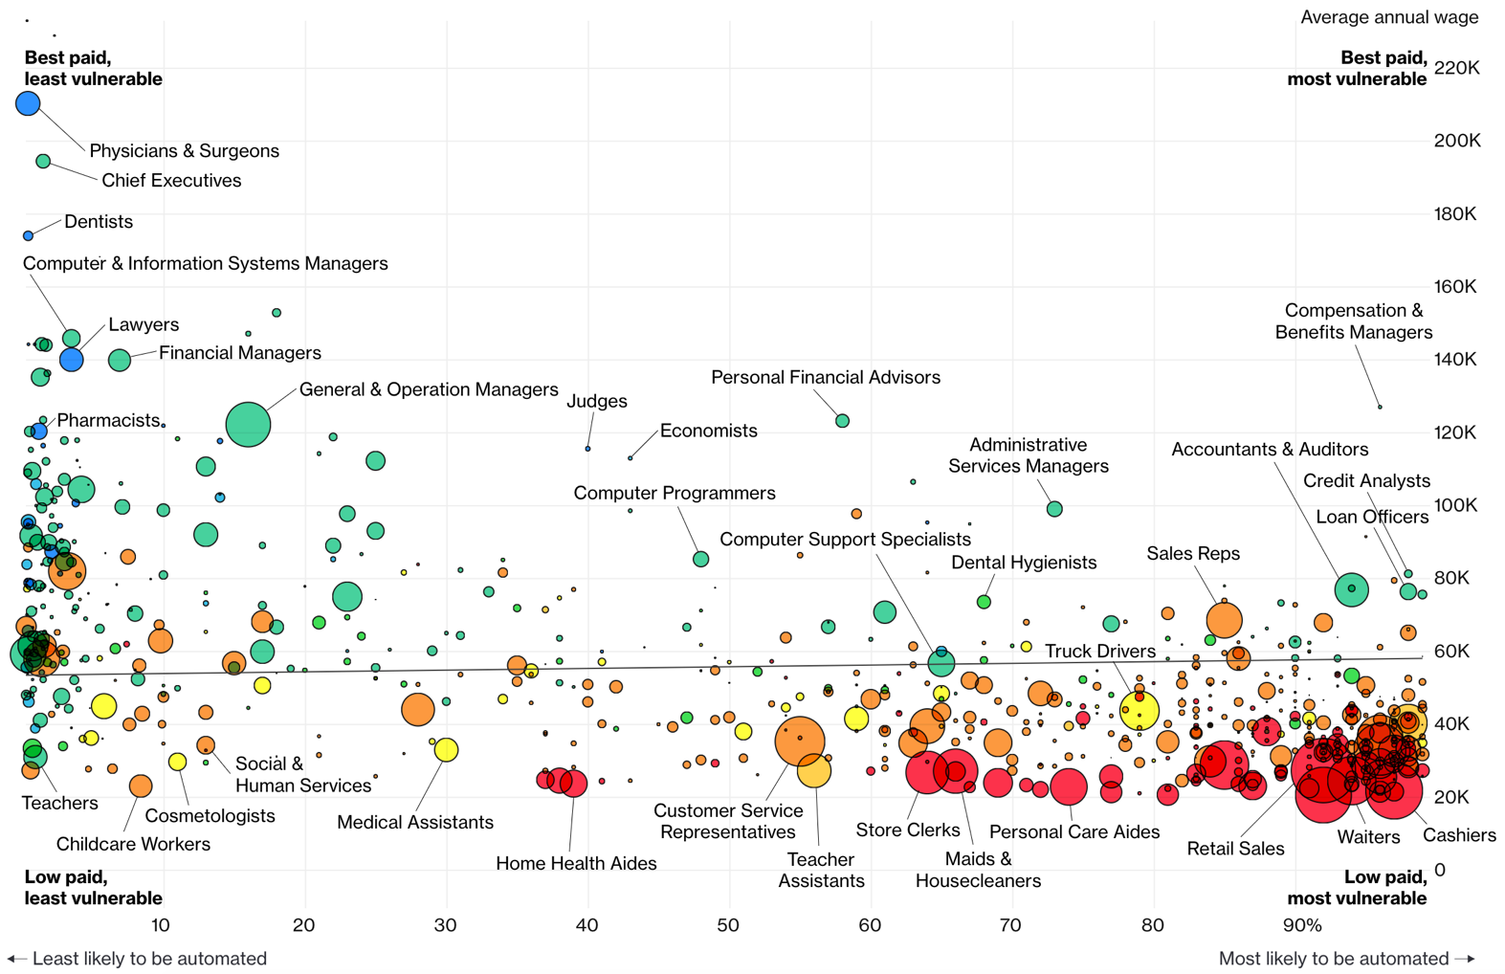
Jobs likely to be displaced by automation (esp. Neural Networks)
Bloomberg 7/2017

Slide 4
Lecture Agenda
Introduction
What is a Convolutional Neural Network (CNN)?
Tensorflow Playground CNN Demo
History of CNN advances
Application of CNNs in Image Analysis
Object Classification (Tensorflow for Poets, flower demo)
Object Detection (Tensorbox, locating mosquito breeding grounds)
Training data headaches
Using video to capture training data more easily
Cautionary notes
Intro
CNN Details
Applications
Training
Caution
Wrap Up
Notes:
Mention deep learning class in the spring

Slide 5
Intro
Edward Preble, Data Scientist at RTI International
IAA Class of 2017
Background:
Degrees in physics, materials science
Worked in semiconductor industry for 15 years
Prior to the IAA:
Little stats
No formal computer science (no python/R experience)
No exposure to deep learning
Notes:
Everyone in the room is either at or well above my level with regard to expertise needed for neural networks when I was in your seat. So, have no fear!
So, if I’m not a professor level expert on this, why am I here at the IAA lecturing on it?

Slide 6
Projects at RTI over last 15 months
IAA Exposure
no
yes/no
yes/no
yes/yes
yes
no
yes
yes
yes
yes
yes
no
yes
yes
Data Visualization
NASA – visualize publication details for the International Space Station (Dashboard)
Police body-worn camera meta-data visualization (SQL, Dashboard)
Federal Contract data visualization (SQL, Dashboard)
Modeling Related
Seizure detection using ECG sensor (Logistic, Basic Neural Networks)
Attego – Financial risk simulation (Monte Carlo Simulations)
Custom object detection in drone videos (Convolutional Neural Networks)
Determine land use in Rwanda via satellite imagery (Logistic)
Determine physiological impact of lighting conditions on workers (Logistic)
Drone route optimization for medical test kit delivery (Optimization)
DTRA – Pre-symptomatically detect if someone is sick (Kolmogorov-Smirnov Distribution Testing)
Detect traumatic brain injury in ECG sensor data (Logistic)
Software Development
Aerosol penetration of protective clothing (Real time image analysis)
Business Related
Confidential Client – AI Research (Report)
Confidential Client – Locate novel data sources for client needs (Report)
Notes:
I did 3 projects for data vis, 8 for modeling, 1 for software dev, and 2 business related. 14 total projects, and the 3 bolded ones were really large projects (big teams).
You might say that’s a lot of projects, but consider how many teams you’ve been on and how many projects you’ve already done here in just a few months. That pace totally prepared me for RTI.
As far at the actual tech work:
For the data vis work, the SQL prep here at the IAA was great for what I needed to accomplish, and I would argue this is not a program to teach how to write javascript code for dashboards, so that isn’t unexpected.
Business related work, these projects were just like practicums, but no actual coding. We just had to brainstorm things for commercial clients who didn’t understand data science very well and give them succinct reports.
For MOST of the modeling and software dev work, I was able to use the Logistic, Monte Carlo, and Optimization, and even basic neural network work directly from my notes as starting points for the work at RTI. I was perfectly prepared for that. However, the more advance convolutional neural network stuff, I had to pick up on the job.
It is my undertanding that you will have coursework on this in the spring, so that is a new add to the program, which is great.
So, even though I’m not an expert, I can pass on what I learned on the job + your coursework, and you’ll hopefully be a few steps ahead of where I was if you actually run into this stuff.

Slide 7
Lecture Agenda
Introduction
What is a Convolutional Neural Network (CNN)?
Tensorflow Playground CNN Demo
History of CNN advances
Application of CNNs in Image Analysis
Object Classification (Tensorflow for Poets, flower demo)
Object Detection (Tensorbox, locating mosquito breeding grounds)
Training data headaches
Using video to capture training data more easily
Cautionary Notes
Intro
CNN Details
Applications
Training
Caution
Wrap Up

Slide 8
What is a CNN?
Network
Interconnected things, sometimes in complex ways
Neural Network
“Neural” because it’s modelled (simplistically) on the human brain
Convolutional Neural Network
Combine 2+ math functions into 1
Intro
CNN Details
Applications
Training
Caution
Wrap Up
Notes:
Neural networks, just like the human brain, there are parts that specialize in different things, like motor skills or vision, a deep neural network also has specializations in the network as well.

Slide 9
CNN Diagram for Image Analysis
All Image Pixels
Edges/Curves
Eyes/Nose
Dog
Input Data
Input Layers
Detection Filters
Simple Features
Detection Filters
Complex Features
Classification
Inception v3
(Google CNN Architecture)
Intro
CNN Details
Applications
Training
Caution
Wrap Up

Slide 10
How are CNN’s going to automate jobs?
CNN’s are enabling a big leap for sensory data processing (auditory, visual, IoT sensors)
Image Recognition Accuracy
Intro
CNN Details
Applications
Training
Caution
Wrap Up

Slide 11
Neural network perfect storm has arrived
Viable NN Products Need:
Availability of Training Data
Complex Models (deep networks)
Hardware (GPUs)
ImageNet Competition Winning Model
Intro
CNN Details
Applications
Training
Caution
Wrap Up
Notes:
Data wise, to train a CNN to identify a complex object, one needs ~10,000 diverse examples of the object
A computer can’t tell a dog and a cat apart with just a few variables
If you have a ton of data, and a very complex model, you need fast computing. Introduction of GPU usage for these calculations was key.

Slide 12
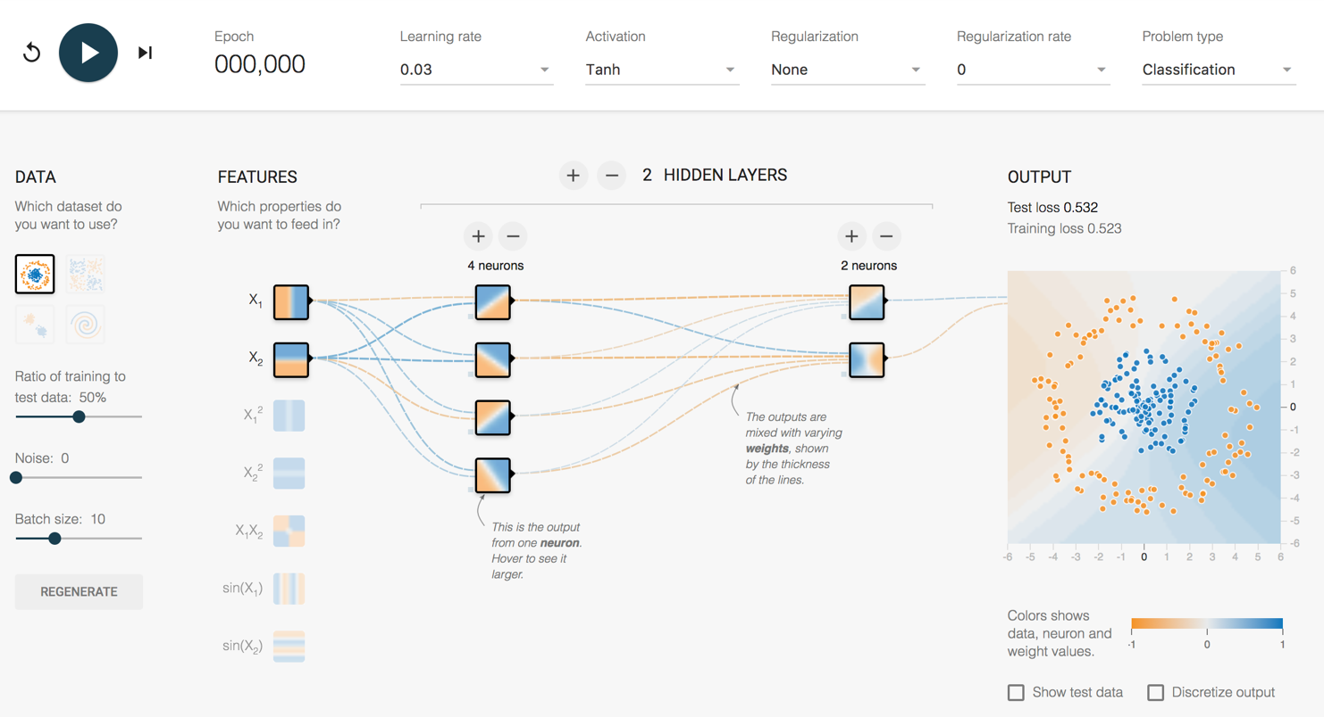
How does it work?
http://playground.tensorflow.org/
Intro
CNN Details
Applications
Training
Caution
Wrap Up

Slide 13
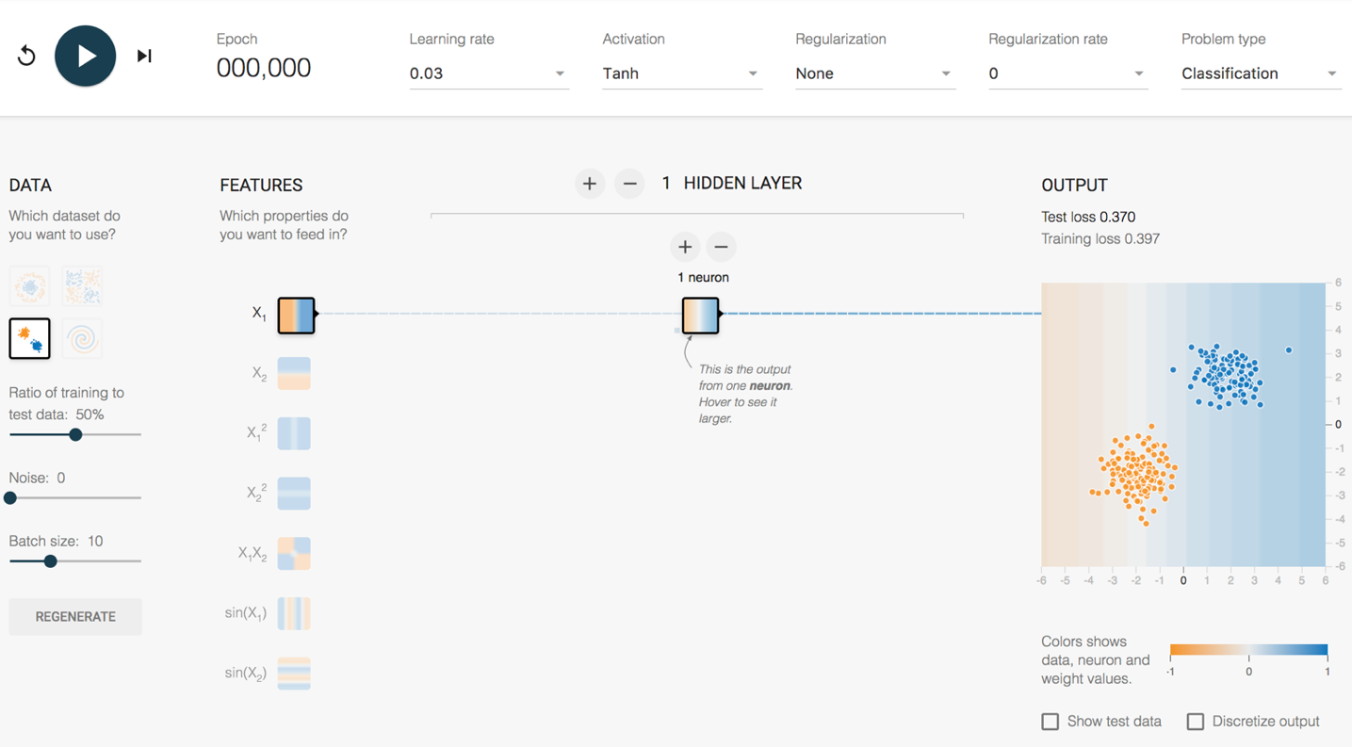
Playground Demo 1
2 Clumps 1 Feature 1 Hidden Layer
1 Neuron
Intro
CNN Details
Applications
Training
Caution
Wrap Up
Notes:
Explain tanh function (similar to logit 0-1, except -1-1)
Dividing line, left is orange, right is blue. Probability of being orange/blue is higher as you go farther from the divide.
Look at random initial weights
Single click advance the model on the vertical feature only
Watch weights increase
Division gets clearer
Test loss gets lower and lower
Reset – show learning rate effect
Activation Function – Tanh, ReLU
Single click advance the model on the horizontal feature only
Single click advance the model on the vertical + horizontal
Show next 3 features that they don’t work
This is a fundamental problem of SHALLOW NETWORKS. Bad feature = Bad results.
Do all 5 together
Weights that increase are said to be ACTIVATED

Slide 14
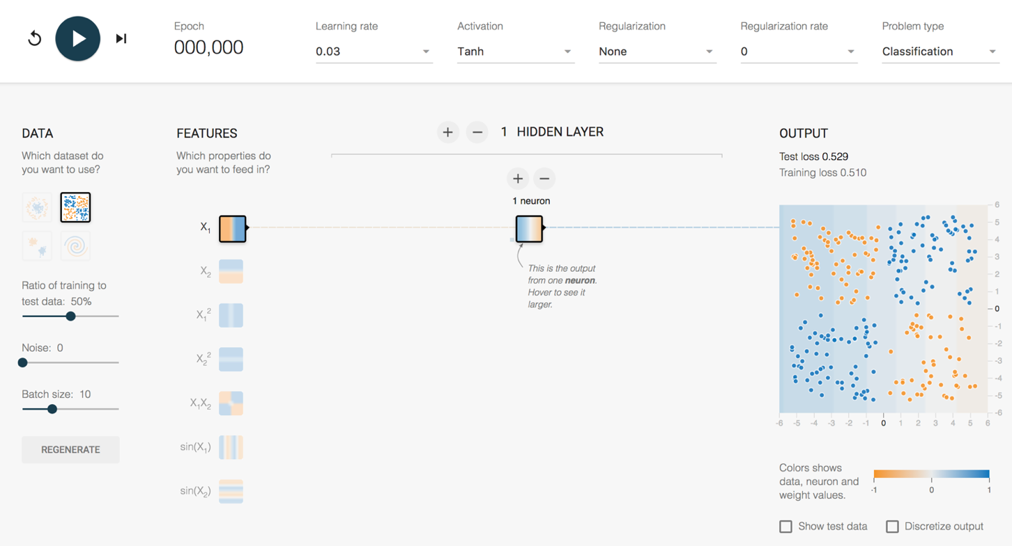
Playground Demo 2
4 Clumps 1 Feature 1 Hidden Layer
1 Neuron
Intro
CNN Details
Applications
Training
Caution
Wrap Up
Notes:
Lets take the same model, and try some transfer learning. Let’s “TRANSFER” this model to new data.
1 feature, 1 layer, 1 neuron – terrible
2 feature, 1 layer, 1 neuron – now get an angle, better
Lets add a second layer
2 feature, 2 layer, 1/1 neuron – Makes no sense to have single neuron into single neuron, can reverse info, but can’t adjust it
Add second neuron to layer 1
2 feature, 2 layer, 2/1 neuron – Sometimes single line, like above. Sometimes more of a “corner”, sometimes makes a valley (best)
Hover over neurons and weights for each neuron to show how it adds up
So, with a small network, what is the best way to make this work?
Use the feature that fits the data better – Choose the X1X2 feature
With small networks of the past, feature engineering was where everyone worked to make this stuff happen. Good features = Good model. Bad features = no luck.
But, what is the magic feature to tell a cat apart from a dog?

Slide 15
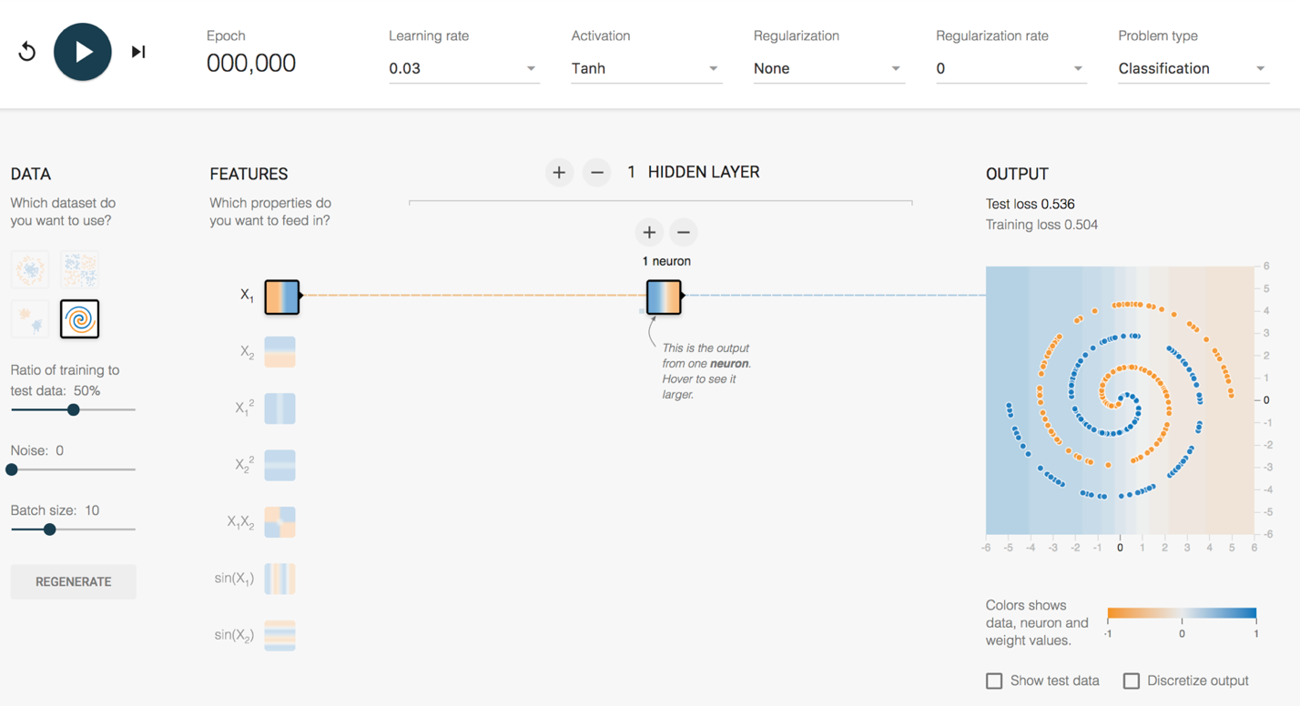
Playground Demo 3
Spiral 1 Feature 1 Hidden Layer
1 Neuron
Intro
CNN Details
Applications
Training
Caution
Wrap Up
Notes:
More complex Shape – Spiral
1 feature, 1 layer, 1 neuron – terrible
All features, - starts making dots
All features , 1 layer, 2 neurons
All features – Keep trying until a semblance of a spiral
All features , 2 layers, 2 neurons, spirals lots of other stuff
All features , 5 layers, top layers are washed out. No new information being generated.
All features , 5 layers, 5/4/3/2/1, might get it
6 layers, 7/6/5/4/3/2, starts working pretty well pretty quickly – weird looking, but works

Slide 16
How does a CNN “Learn”?
Backpropagation
Initial network settings are random
Test prediction using training data
Adjust network by a certain amount (Learning Rate) to reduce the error
Start at the end of the network and work backwards
?
Dog
Dog
Dog
?
Cat
Cat
Cat
?
?
Intro
CNN Details
Applications
Training
Caution
Wrap Up

Slide 17
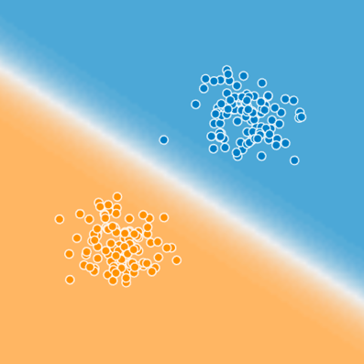

Is that it?
Blue
Cat
Cat
Typing
on
Laptop
Cat
Typing
on
Laptop
in the
Kitchen
How to get to here?
Orange
Intro
CNN Details
Applications
Training
Caution
Wrap Up
Notes:
So, is that it? Now I know how to separate color blind appropriate color dots? I need to know more to tackle the internet’s most important activity, which is working on cat videos. I need code that can tell me that this is a cat, typing on a laptop, in the kitchen.
Can tensorflow playground do that? No, obviously it can’t. We need much more sophisticated models.

Slide 18
How complex are these things?
All Image Pixels
Edges/Curves
Eyes/Nose
Dog
Input Data
Input Layers
Detection Filter
Simple Features
Detection Filter
Complex Features
Classification
Inception v3
(Google CNN Architecture)
Number of Parameters = 23,200,000
Number of Layers = 48
Intro
CNN Details
Applications
Training
Caution
Wrap Up
Notes:
Back to the structure of the CNN, and how these layers start really working for complex images.
For an image, the input layers, instead of being data points like the playground example, they will be the actual pixel values for the image. The last model I used at RTI had 704x704 pixel input images, with 3 colors (RGB), which translates into ~1.5M input neurons.
So, you feed this image into the network, certain neurons and features will “activate”, which will then output at the end, is it blue or orange? Is it a cat or a dog?
On Inception v3, the number of layers is 48, the number of parameters is ~23M, the number of multiply/add calculations per sweep is ~5B.
This is DEEP LEARNING. There is a ton going on under the hood.

Slide 19
Lecture Agenda
Introduction
What is a Convolutional Neural Network (CNN)?
Tensorflow Playground CNN Demo
History of CNN advances
Application of CNNs in Image Analysis
Object Classification (Tensorflow for Poets, flower demo)
Object Detection (Tensorbox, locating mosquito breeding grounds)
Training data headaches
Using video to capture training data more easily
Cautionary Notes
Intro
CNN Details
Applications
Training
Caution
Wrap Up

Slide 20
History of CNN Advances (Early)
1943 – Model an algorithm on human neurons
1970s/80s
Computers gaining broad acceptance, but computational speed still too slow
1990 - Yann Lecun (Bell Labs, now at Facebook)
Number recognition using LeNet (first CNN application)
Big Data? 60,000 hand written post office zip code samples
2006 - Geoff Hinton (Univ. of Toronto, now at Google)
Stacked several shallow networks together → First “Deep Network” (4-8 layers)
2009 - Geoff Hinton
Trained voice recognition network in <3 weeks
Matched state of the art tech that took decades to build
Intro
CNN Details
Applications
Training
Caution
Wrap Up
Notes:
https://www.youtube.com/watch?v=n6XSDA3kfEw
http://slazebni.cs.illinois.edu/spring17/lec01_cnn_architectures.pdf

Slide 21
History of CNN Advances (Recent)
2011 -
For image recognition, typical networks were shallow (~4 layers)
2012 – Geoff Hinton (again)
AlexNet, 8 layers
Major image analysis breakthrough
Huge leap for CNNs. Python based. GPU trained.
2014
22 layers – Inception v1 (GoogLeNet)
2015
48 Layers – Inception v3
152 Layers – ResNet
2017
Tensorflow libraries open-sourced by Google
Intro
CNN Details
Applications
Training
Caution
Wrap Up

Slide 22
How long to train 23,200,000 parameters?

Slide 23
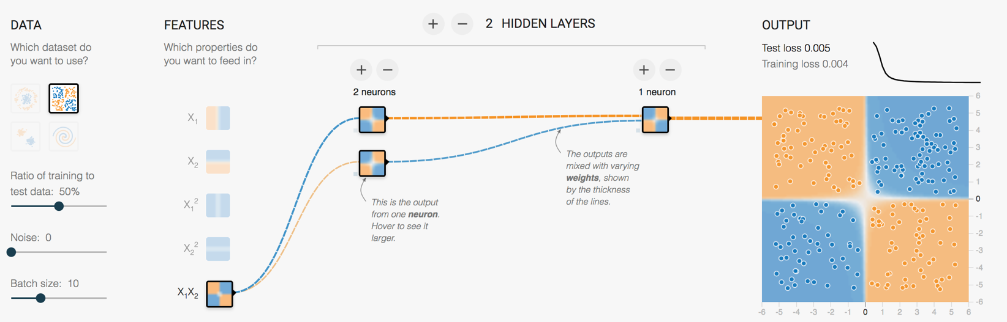
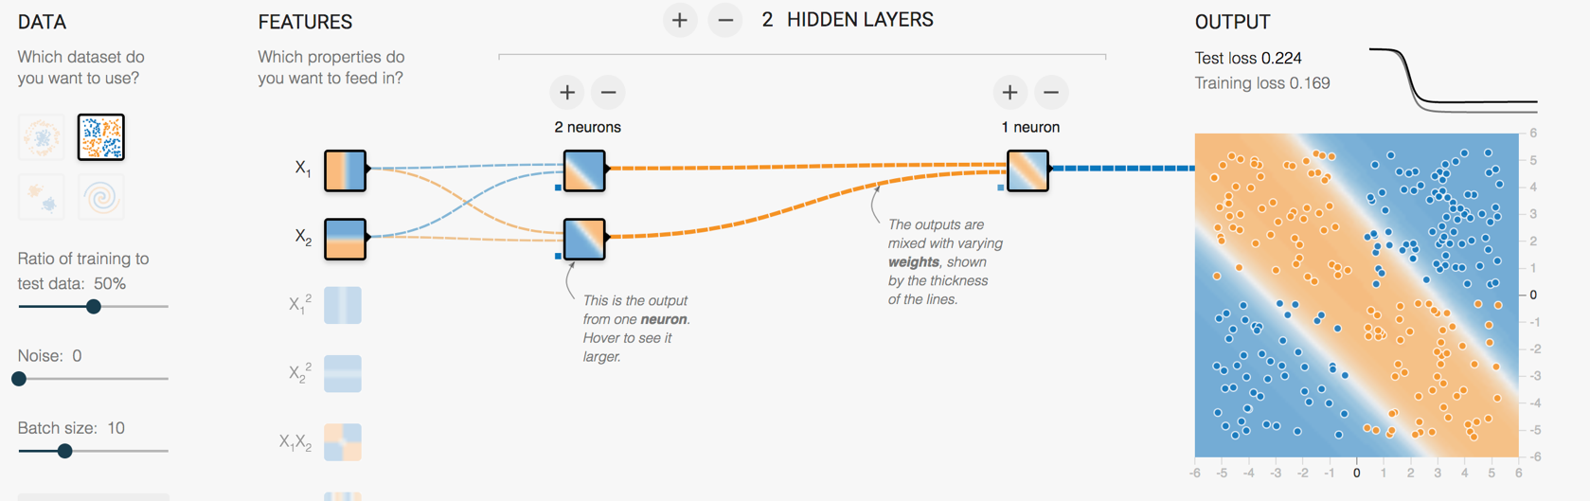
Another key advance
Retraining the last layer is all that is needed for basic human recognizable objects
ImageNet trained weights for Inception v3 are downloadable
Intro
CNN Details
Applications
Training
Caution
Wrap Up
Notes:
Remember beginning of lecture, to make the 4 blob data work, we could battle with linear features and a few layer/neuron combos
Or, just needed to use the right feature and it works instantly
Google (and others) have figured out those features and pre-trained a number of model architectures

Slide 24
Where are we today
Computational platform → Tensorflow
Model architecture → Inception_v3 structure
ImageNet pre-trained weights
Python scripts to handle the retraining
Intro
CNN Details
Applications
Training
Caution
Wrap Up

Slide 25
Lecture Agenda
Introduction
What is a Convolutional Neural Network (CNN)?
Tensorflow Playground CNN Demo
History of CNN advances
Application of CNNs in Image Analysis
Object Classification (Tensorflow for Poets, flower demo)
Object Detection (Tensorbox, locating mosquito breeding grounds)
Training data headaches
Using video to capture training data more easily
Cautionary Notes
Intro
CNN Details
Applications
Training
Caution
Wrap Up

Slide 26
Applications of CNNs in Image Analysis
Classification
& Localization
Instance
Segmentation
Classification
Object Detection
Intro
CNN Details
Applications
Training
Caution
Wrap Up

Slide 27
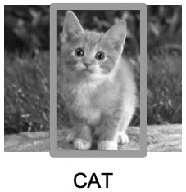
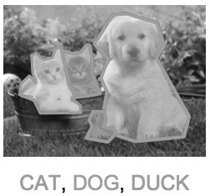
Applications of CNNs in Image Analysis
Classification
& Localization
Instance
Segmentation
Classification
Object Detection
Intro
CNN Details
Applications
Training
Caution
Wrap Up

Slide 28
Object Classification
Original Demo from Google: https://codelabs.developers.google.com/codelabs/tensorflow-for-poets
Jupyter Notebook Demo: http://localhost:8888/notebooks/Image_Classification_Tensorflow_for_Poets.ipynb
My notebooks available for download at GitHub https://github.com/epreble/ncsu_iaa_cnn_guest_lecture.git
Intro
CNN Details
Applications
Training
Caution
Wrap Up
Notes:
There is a google demo, called tensorflow for poets, that we can check out.
This demo will create an image classifier that can classify 5 types of flowers.
I’m going to go through the setup quickly, but I have created a jupyter notebook that you can download later to mimic this. My notebook has more detail, especially on installation, which might make it easier to get this thing working for you.
1. Setup of tensorflow
2. Download code to retrain the model
3. Download training pictures
4. My notebook deviates from the demo a little here, because there are bugs that I want to point out, and because I want to actually hold out some of the images to test with later on.
5. I copy 15 images out of the training folder so the model will never see them.

Slide 29
Lecture Agenda
Introduction
What is a Convolutional Neural Network (CNN)?
Tensorflow Playground CNN Demo
History of CNN advances
Application of CNNs in Image Analysis
Object Classification (Tensorflow for Poets, flower demo)
Object Detection (Tensorbox, locating mosquito breeding grounds)
Training data headaches
Using video to capture training data more easily
Cautionary Notes
Intro
CNN Details
Applications
Training
Caution
Wrap Up

Slide 30
Existing Applications of Object Detection
Autonomous driving – All driving context objects
Manufacturing – Anomaly detection for quality control
Face recognition – Customer or friend identification
People counting – Store visitor or crowd counting
Online image censoring – Nudity, violence, contraband detection
Security – Automated detection of weapons, intruders
Intro
CNN Details
Applications
Training
Caution
Wrap Up

Slide 31
Object Detection – RTI Use Case
Mosquito breeding site identification in Guatemala
Current Solution
Walking teams
Desired Solution
Target map assists walking team
Intro
CNN Details
Applications
Training
Caution
Wrap Up

Slide 32
Lecture Agenda
Introduction
What is a Convolutional Neural Network (CNN)?
Tensorflow Playground CNN Demo
History of CNN advances
Application of CNNs in Image Analysis
Object Classification (Tensorflow for Poets, flower demo)
Object Detection (Tensorbox, locating mosquito breeding grounds)
Training data headaches
Using video to capture training data more easily
Cautionary Notes
Intro
CNN Details
Applications
Training
Caution
Wrap Up

Slide 33
Organizing Image Training Data
Can be VERY time consuming
Data science 80/20 rule
Object Detection Requires:
Images
Object class bounding boxes
Different input file types
Image1, Cat, x/y coordinates
Intro
CNN Details
Applications
Training
Caution
Wrap Up

Slide 34
Real world images can be very busy
Intro
CNN Details
Applications
Training
Caution
Wrap Up

Slide 35
A better way
Use Video & Object Tracking to generate lots of training images Demo Object_Tracker_for_Video.py
Intro
CNN Details
Applications
Training
Caution
Wrap Up
Notes:
Object tracker for Drone Use Case
Just perfectly labeled 3720 images for a unique object case!
In Pycharm, switch to Charlie Chaplin
Works for Chaplin
Doesn’t work for couple behind him

Slide 36
Lecture Agenda
Introduction
What is a Convolutional Neural Network (CNN)?
Tensorflow Playground CNN Demo
History of CNN advances
Application of CNNs in Image Analysis
Object Classification (Tensorflow for Poets, flower demo)
Object Detection (Tensorbox, locating mosquito breeding grounds)
Training data headaches
Using video to capture training data more easily
Cautionary Notes
Intro
CNN Details
Applications
Training
Caution
Wrap Up
Notes:
Good place for questions!

Slide 37
Gartner Hype Cycle for 2017
Intro
CNN Details
Applications
Training
Caution
Wrap Up

Slide 38
3 Major Areas for Caution
Artificial Intelligence Hype
Data Bias
Model Bias

Slide 39
Spot the HYPE
Use existing HR data
Tell me how to use our HR data to predict employee retention rates
Tell me how to use our HR data to generate higher profits
Use “AI” to
Find all the patents that will lead to products that are competitive with ours
Analyze twitter data for social trends related to e-cigarettes
Aggregate all your company data into a data lake and
Predict xyz
Notes:
AI is NOT yet a general purpose tool
Going to repeat that: AI is NOT yet a general purpose tool
AI can be used for highly specific, well defined, and usually data rich use cases

Slide 40
Data Bias
Where would you add armor?
Help the plane steer
Help the plane land
Protect the people on the plane
1
1
3
2
World War 2 Post-Mission Bomber Damage Locations

Slide 41
Model Bias
What if a flower classification model is better at roses than tulips?
What if a facial recognition model is better at Caucasian faces compared with African American faces?
How might that impact real people?
Don’t ignore the ethics of how a model might be applied. Make those discussions happen.
Ignoring ethical bias can land your company on CNN
Demonstrating ethical leadership can build your brand, prevent customer surprises, and help highlight/reduce model bias
Intro
CNN Details
Applications
Training
Caution
Wrap Up

Slide 42
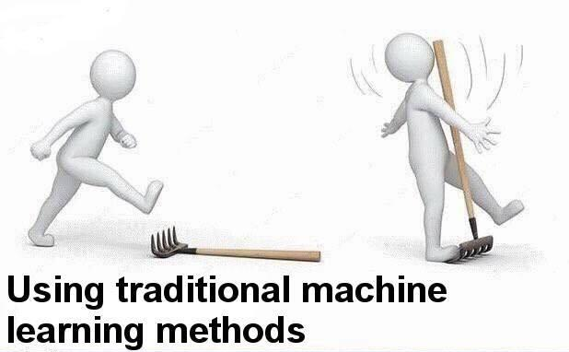
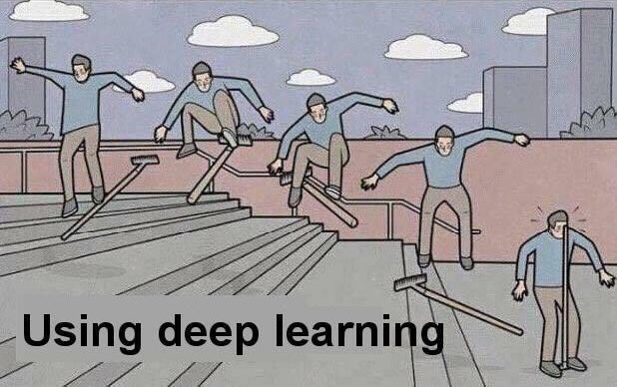
Sometimes Simple is Better

Slide 43
Resources to Learn More
Entry Level Videos:
Josh Gordon (Google) Machine Learning Tutorials https://www.youtube.com/watch?v=cKxRvEZd3Mw
Siraj Raval - Various Artificial Intelligence Videos https://www.youtube.com/channel/UCWN3xxRkmTPmbKwht9FuE5A
More Advanced
Adrian Rosebrock (Lots of Python and OpenCV Materials) https://www.pyimagesearch.com/
Geoffrey Hinton’s Coursera Class https://www.coursera.org/learn/neural-networks
Intro
CNN Details
Applications
Training
Caution
Wrap Up

Slide 44
Thanks!
Break Time!
Optional demo next
Demo goals:
Train an Inception v3 model to recognize 3 students
Use video to get 200+ training images quickly
Train the model and test it!
Intro
CNN Details
Applications
Training
Caution
Wrap Up

